Slide 1
Preventing the Pain of Digital Loss
Janelle Jenstad and Martin Holmes University of Victoria Humanities Computing and Media Centre

Slide 2
Outline
Who we are and what we do
What we used to do 20+ years ago
The advent of exciting new tools
Problems with the new approach:
Sporadic/partial publication with missing dependencies
Uncitability
Maintenance burden and security risks (Tamagotchi projects)
We were thinking like software devs. How about thinking like humanists?
How book editions have worked for centuries (Speculum pecatris)
How can we use this model for digital editions? (Pet rock projects)
Endings principles.
Everything we gain.

Slide 3
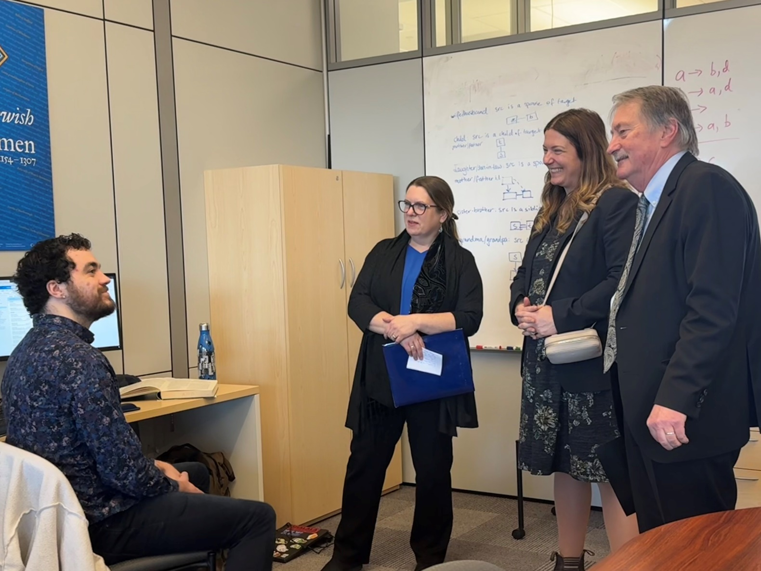
What is HCMC?
Humanities Computing and Media Centre
Set up in the mid-1990s​
Provides programming support for research and teaching in the Humanities​
Includes a lab where researchers and teams can work
Notes:
JJ

Slide 4
What is HCMC?
Has published hundreds of digital resources over the years​
Many of these are large-scale digital editions, such as:​
The Map of Early Modern London (13,257 pages, mapoflondon.uvic.ca)​
The Colonial Despatches of BC and Vancouver Island (10,827 pages, bcgenesis.uvic.ca)​
The Landscapes of Injustice Archive (154,846 pages, loi.uvic.ca/archive)​
Notes:
JJ

Slide 5
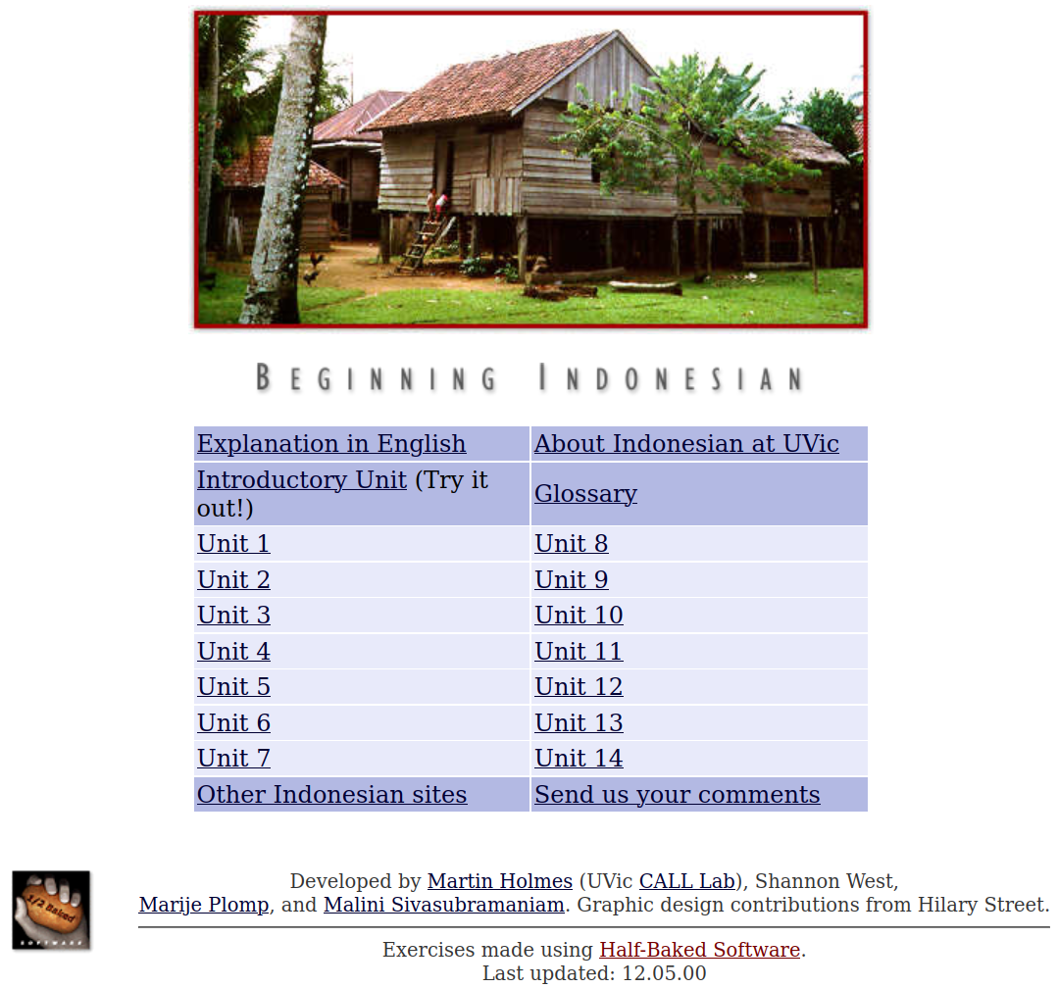
The 1990s
We made websites mostly to support language teaching.​
We build lots of interactive exercises using HTML, CSS and JavaScript.​
Most of these sites have never been updated – see for example:​
web.uvic.ca/hrd/indonesian/​
Notes:
MH

Slide 6
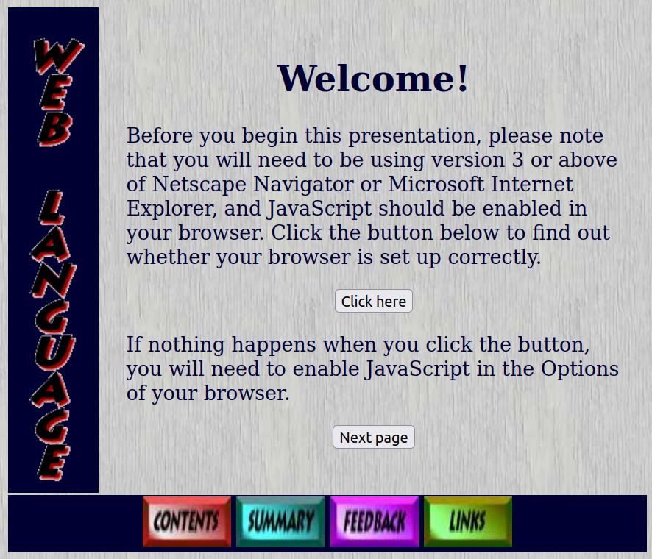
The 1990s
These sites all still work – even though they look SOOO 1990s:​
web.uvic.ca/lancenrd/martin/weblang/
No maintenance burden from these sites!

Slide 7
The early 2000s
Digital Humanities became a thing.
New technologies came along.
We got ambitious and enthusiastic, and started building larger, more complex sites with:
ASP
MySQL, PostgreSQL, PHP
Apache Cocoon
The eXist XML database
...and lots of other cool new tools.​

Slide 8
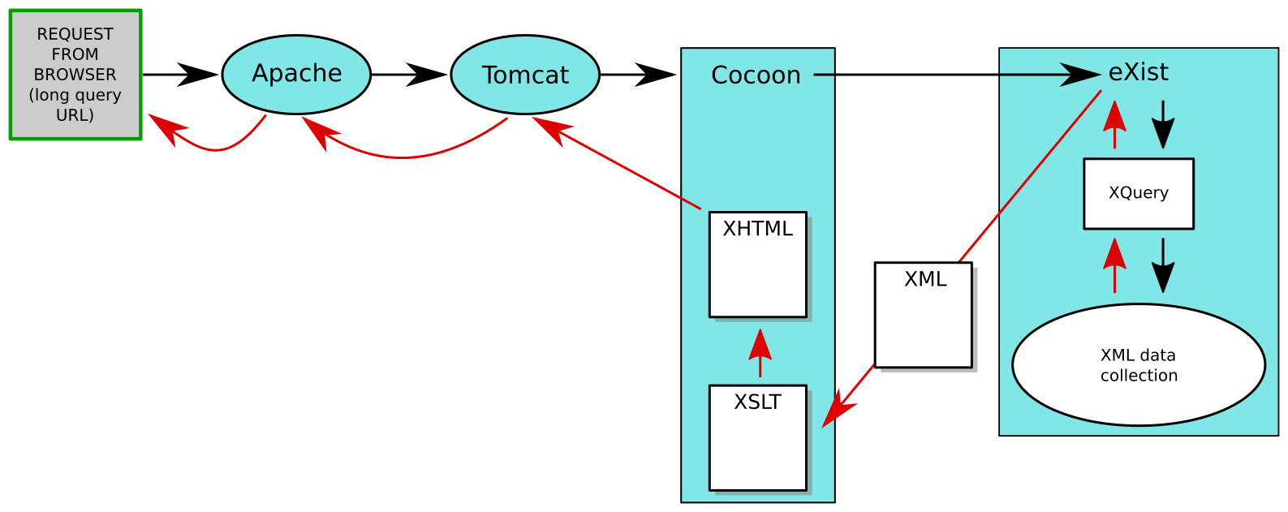

Slide 9
Apparent advantages of this sort of stack
​Changes to output rendering propagate instantly to the whole collection.
Individual documents can be published as soon as they’re ready (“rolling publication”).

Slide 10
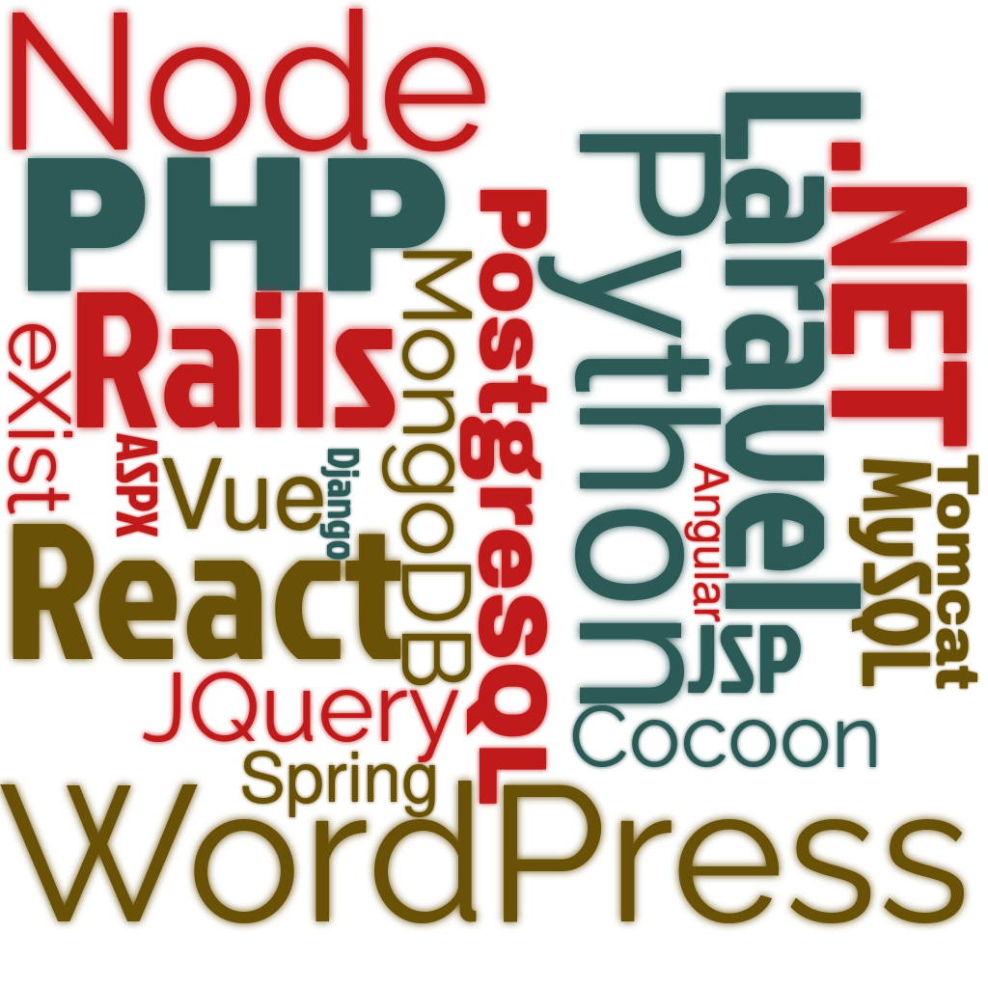
BUT: Horrible technical debt

Slide 11

BUT: Horrible technical debt
Update Java: Tomcat breaks.
Update Tomcat: Cocoon breaks.
Update Cocoon: eXist breaks.
Update eXist: XQuery has to be
rewritten.
...
OS update requires MySQL update.
MySQL update requires PHP update.
PHP update requires code rewrite.
...
Miss an update and your site is vulnerable to attack.
...

Slide 12
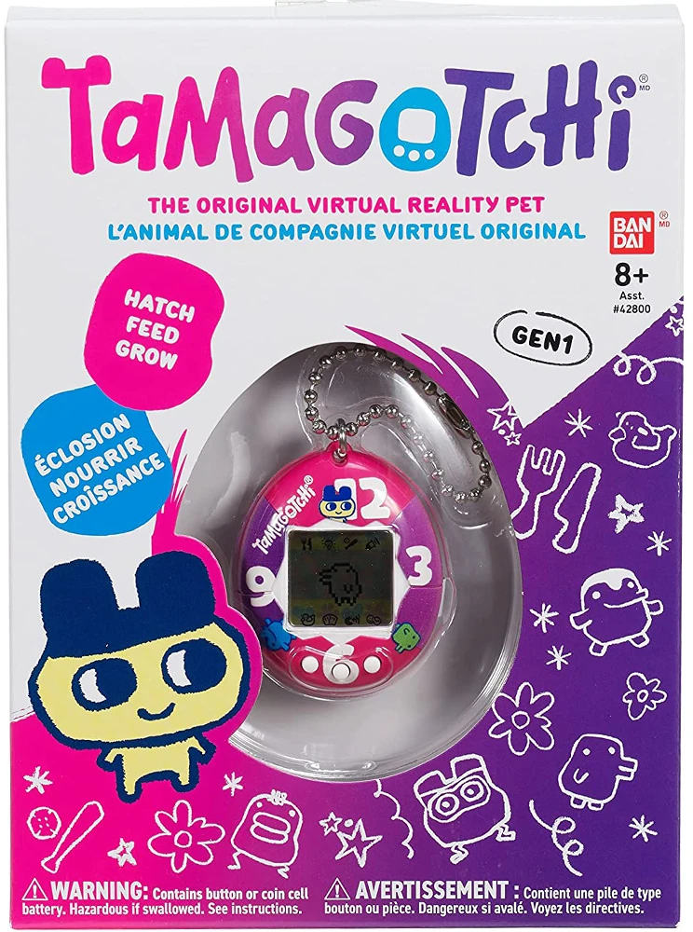
Now every project is a Tamagotchi.
Life is nothing but maintenance.
There’s no time for new projects.

Slide 13
But wait – it’s worse. Remember this?
Individual documents can be published as soon as they’re ready (“rolling publication”).
It seemed like a good idea at the time...

Slide 14
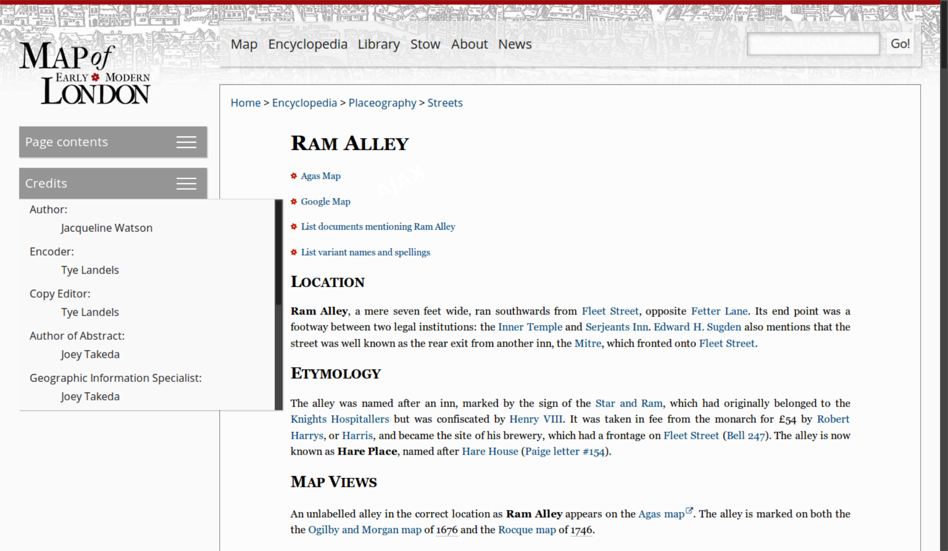
The trouble is, there’s no such thing as a document.

Slide 15
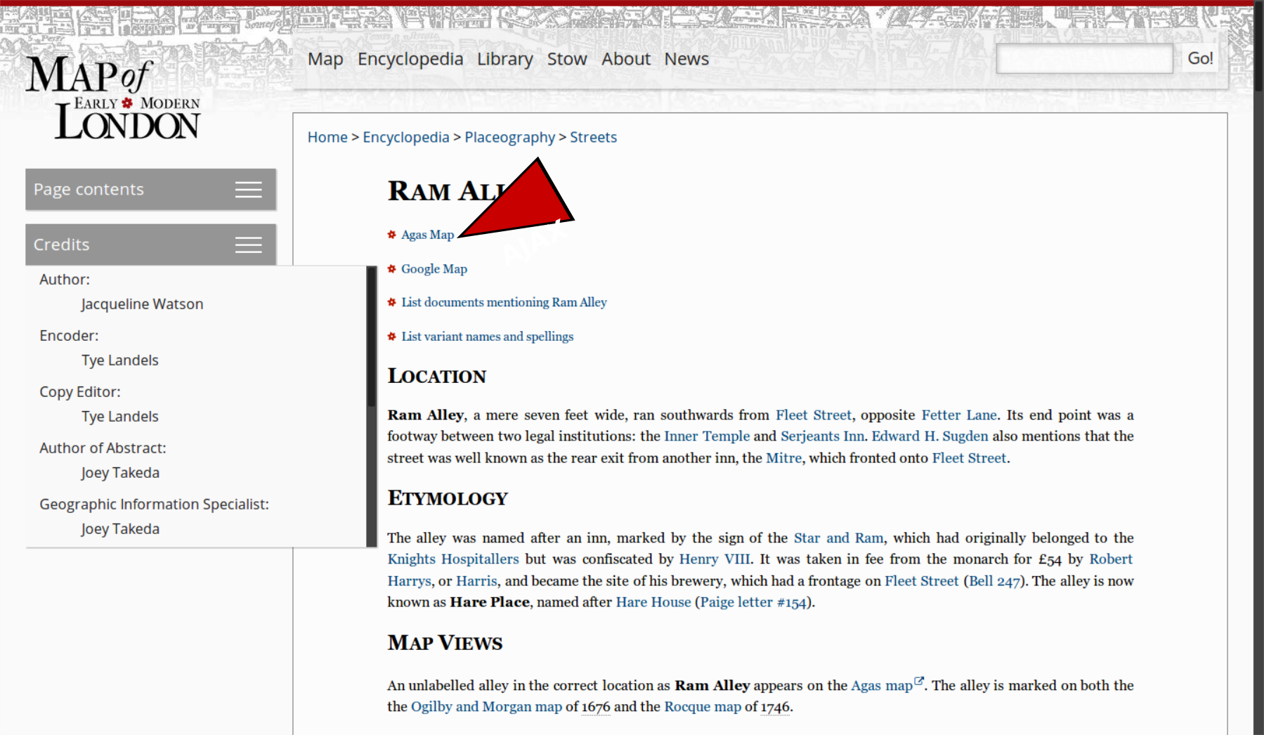
The trouble is, there’s no such thing as a document.

Slide 16
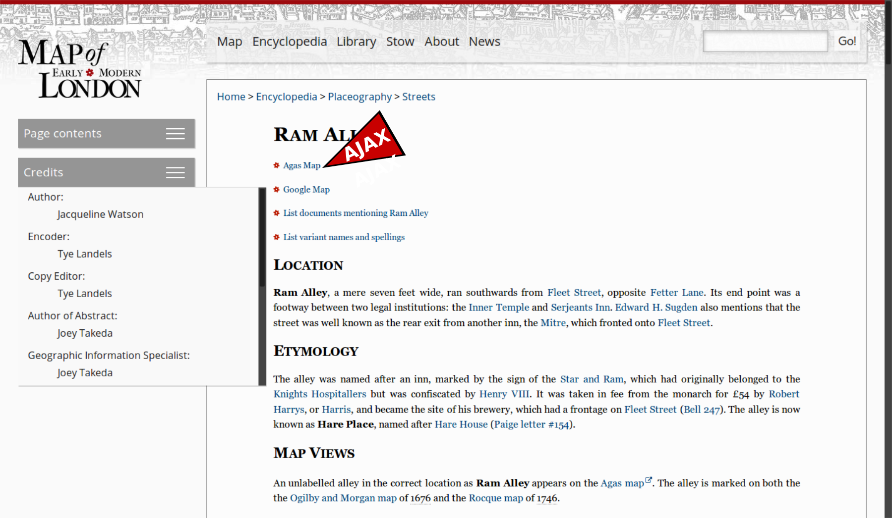
The trouble is, there’s no such thing as a document.

Slide 17
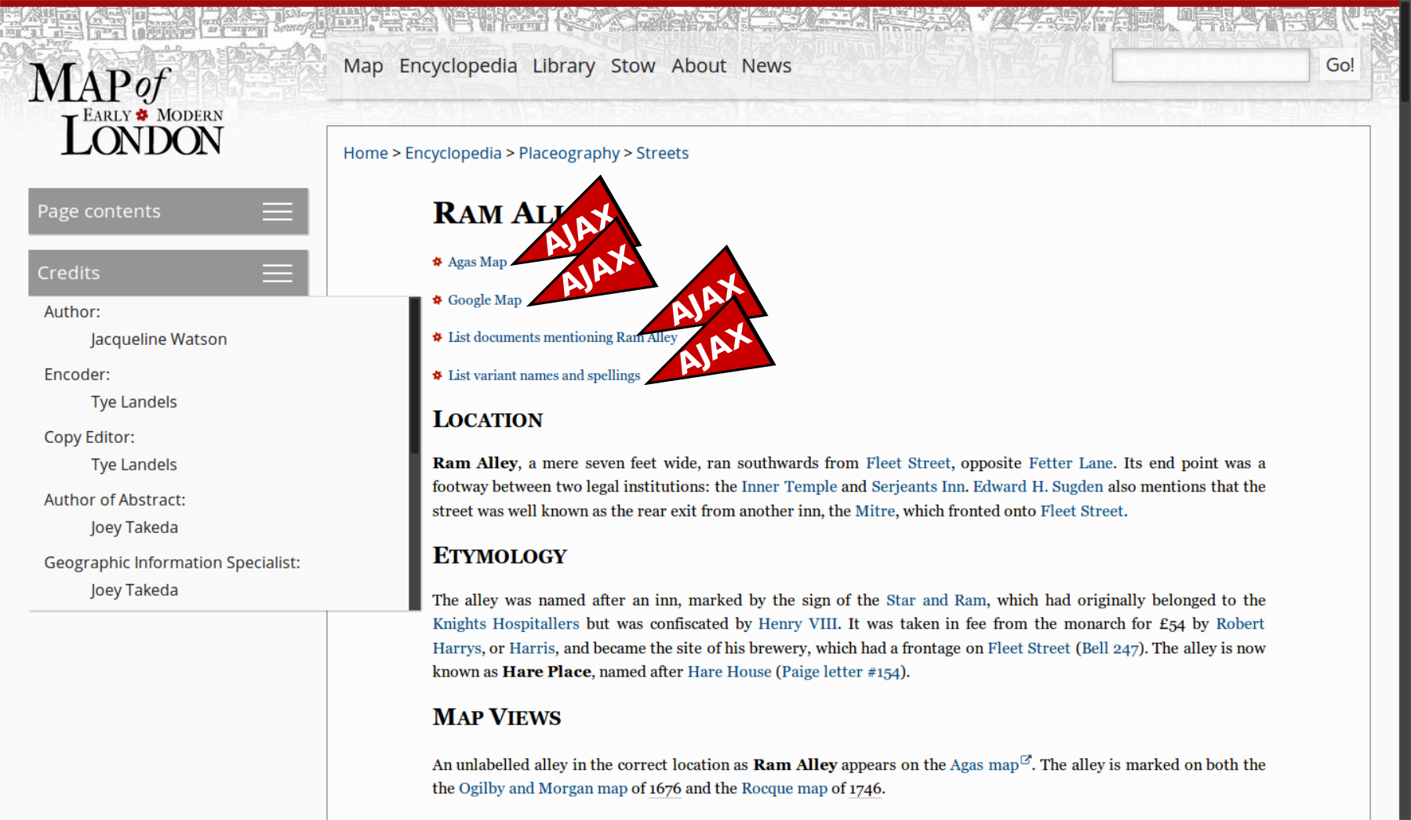
The trouble is, there’s no such thing as a document.

Slide 18
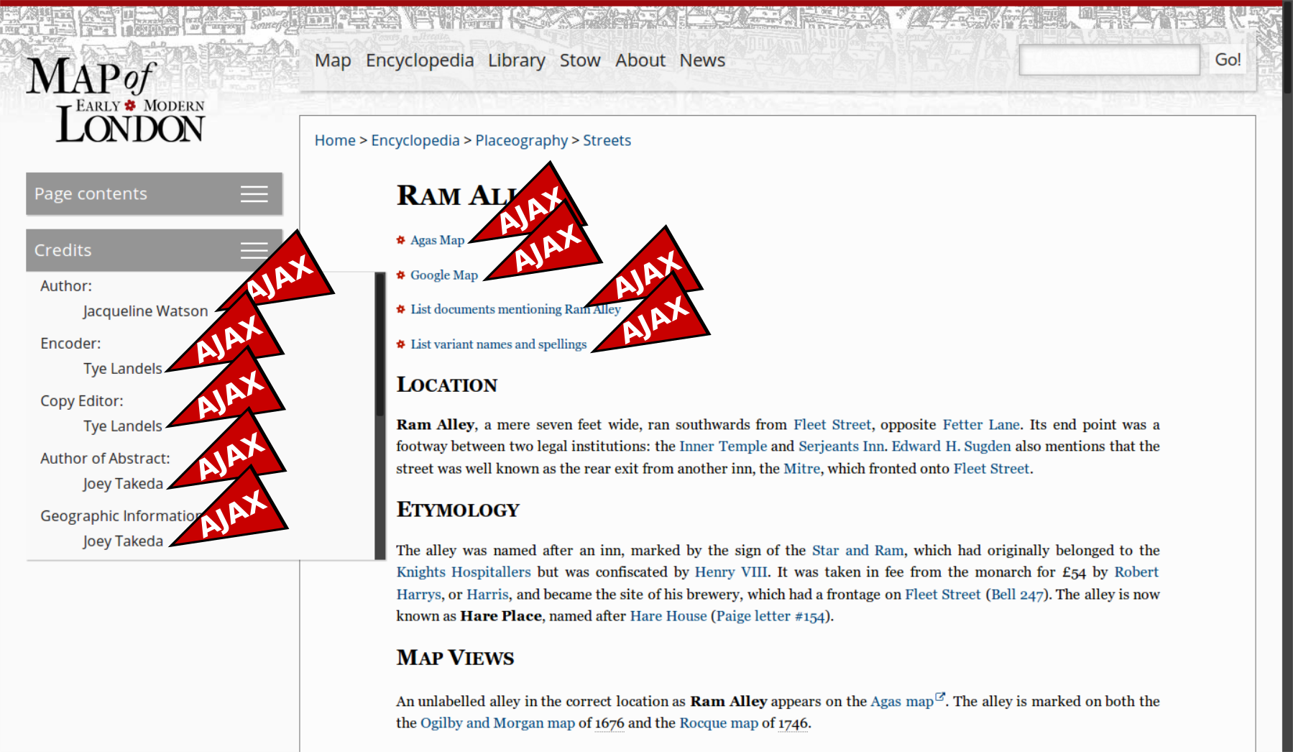
The trouble is, there’s no such thing as a document.

Slide 19
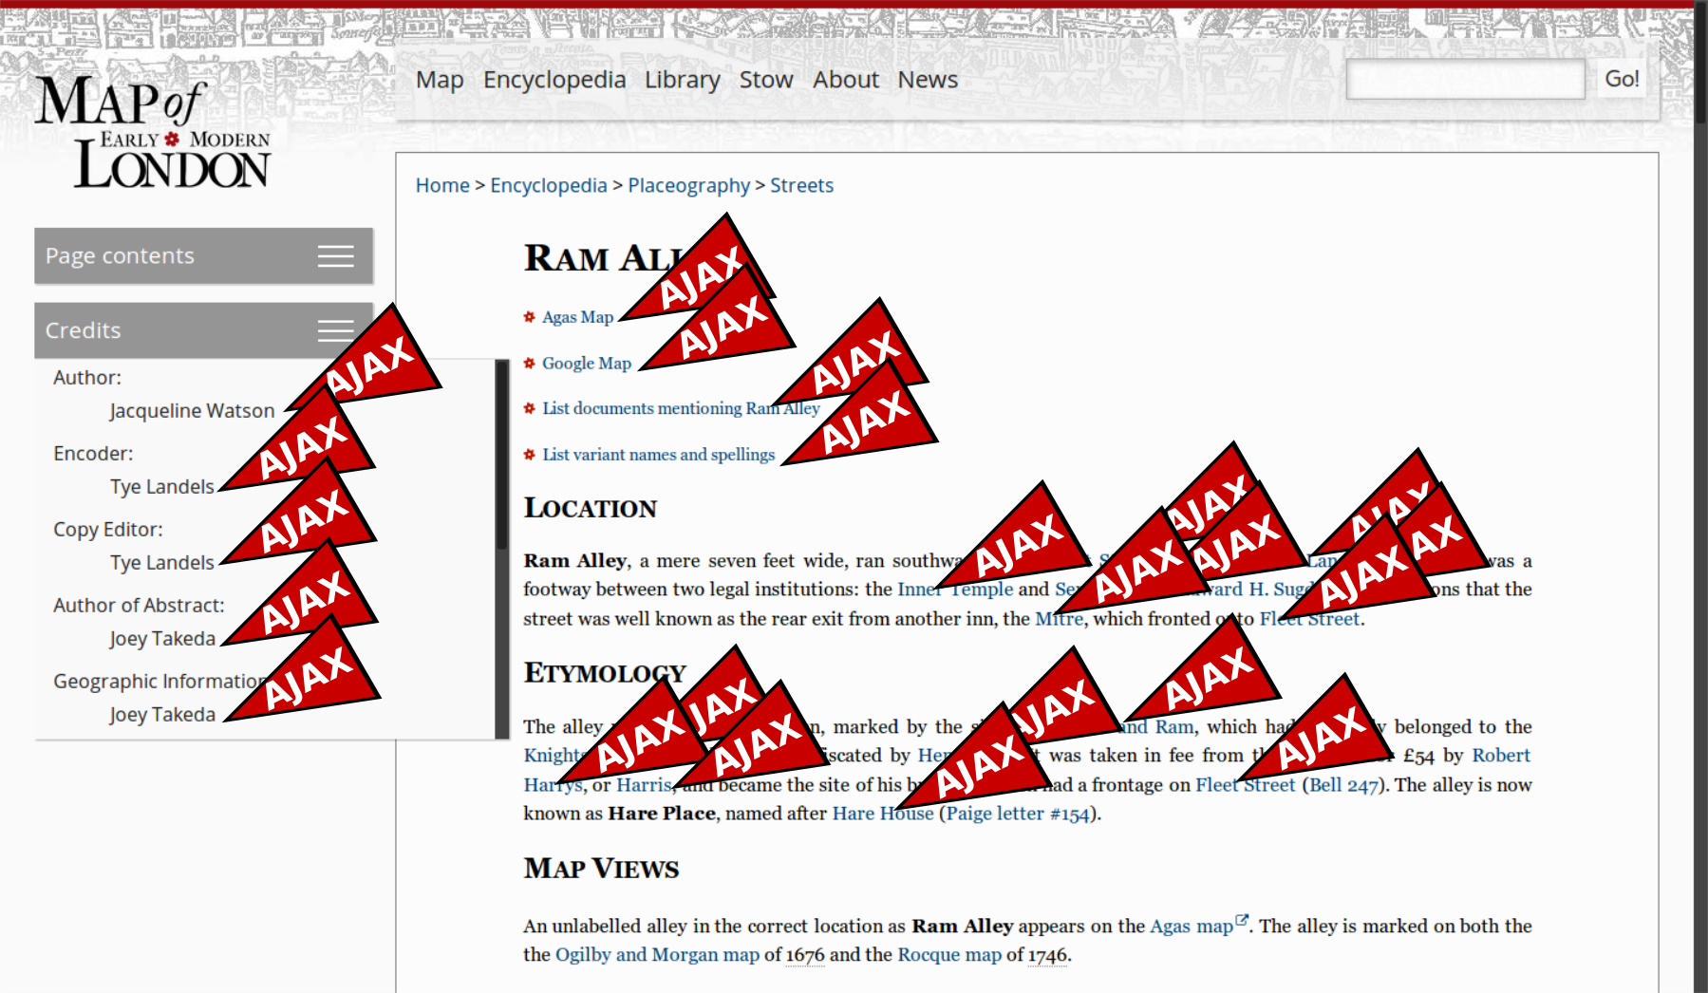
The trouble is, there’s no such thing as a document.

Slide 20
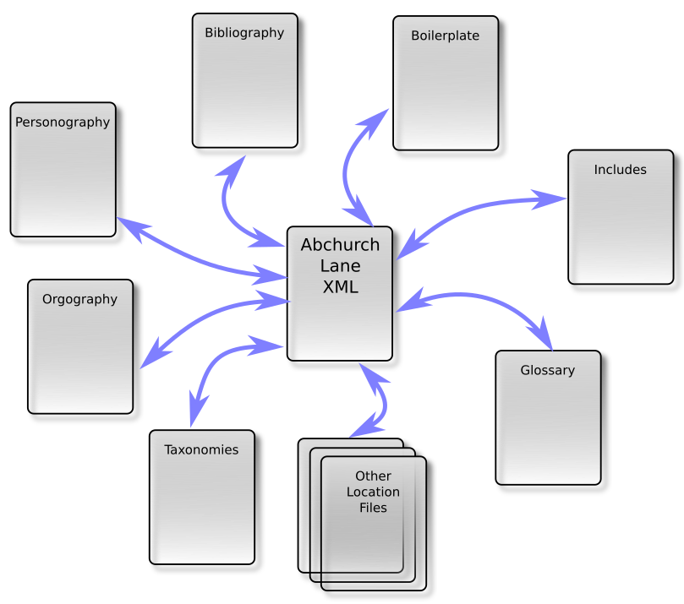
A digital edition is a network, not a collection of discrete docs.

Slide 21
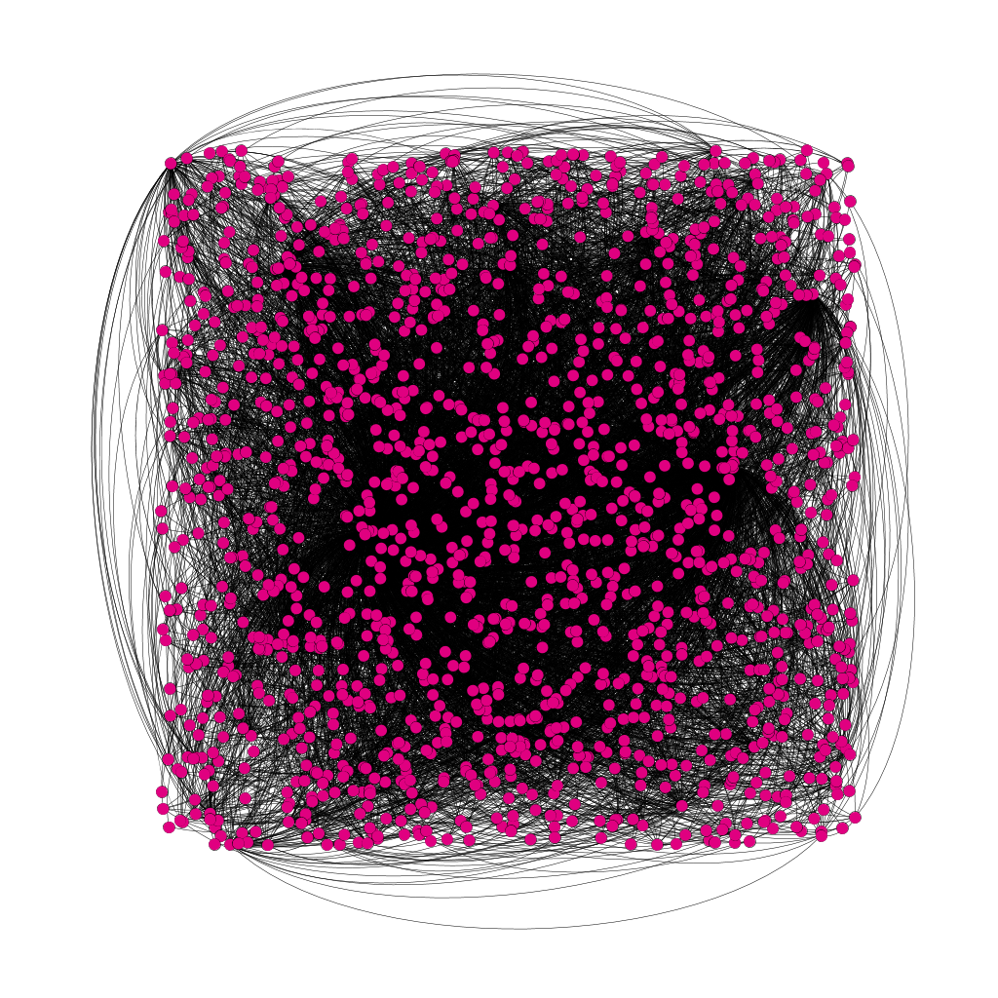
Network map of MoEML

Slide 22
The scholarly corollary
​Changes to one “document” cause changes to other “documents”.
There is no reliable way to cite a “page”.
There’s no way to get back to the version of a “page” you saw last week.
So nobody will cite the project.
So the scholars involved will not win prizes/get tenure/get grant money/be happy and successful.

Slide 23
So the Tamagotchi model is:
​bad for developers because they spend their lives on maintenance; and
bad for scholars because their work appears untrustworthy and uncitable.
So let’s stop thinking like software developers, and start thinking like proper humanists.

Slide 24
What books got right
German Edition (1537)
Dutch editie (1546)
English edition (1556)
Italian edizione (1575)
Notes:
JJ

Slide 25
“edition”
Edmund Coote, The English Schoolmaster (1596): “putting forth”
John Florio, A World of Words (1598): “a setting foorth, a publishing, a creating or an edition”
Robert Cawdrey, A Table Alphabetical (1604): a “putting fourth, setting abroade”

Slide 26
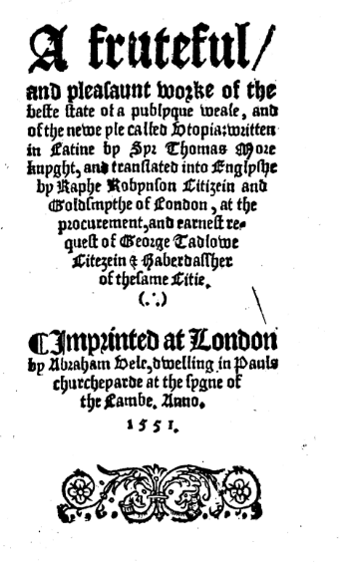
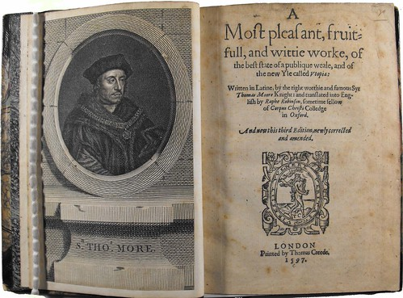
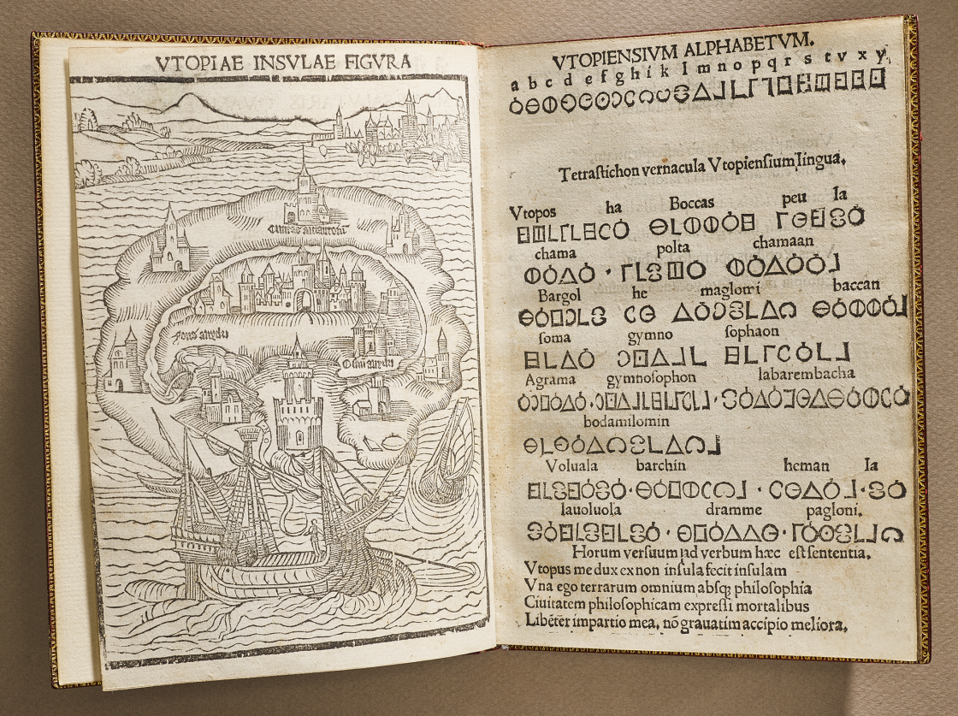
Utopia
By Thomas More
1516
Notes:
1516 (NYPL), 1551, 1556

Slide 27
New Edition as New Text
I haue now in this seconde edition taken about it such paines, yt verye fewe great faultes & notable errours are in it to be founde.
– Ralphe Robynson, second edition of his translation of
Thomas More’s Utopia, 1556 (A3v)

Slide 28
New edition as text
A printed version of a given work that may be distinguished from other versions … by its membership of a complete batch of copies printed from the same setting of type, usually at the same time and place. These batches come to be numbered as first, second, third, etc. editions, each time a new version is set again from fresh type.
- Baldick, Oxford Dictionary of Literary Terms

Slide 29

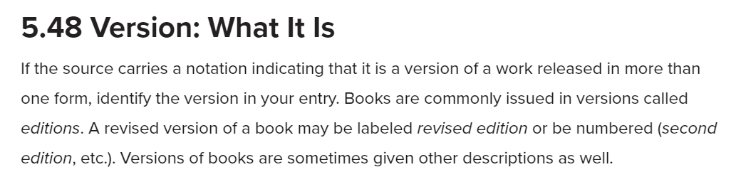
Editions ≈ Versions
Notes:
Hand over to Martin at the end of this slide.

Slide 30
Rolling releases ≈ wikis
… you should never end your research with Wikipedia or another wiki. Instead, use such sites at the very beginning stages of your research to gather basic information and sources and then move on to more credible sources.
– Ellen C. Carillo, MLA Guide to Digital Literacy, 104
Notes:
Mention the WikiBooks edition of The Devonshire Manuscript.

Slide 31
Wikis don’t trust wikis
Wikipedia is not a reliable source for citations elsewhere on Wikipedia. As a user-generated source, it can be edited by anyone at any time, and any information it contains at a particular time could be vandalism, a work in progress, or simply incorrect.
https://en.wikipedia.org/wiki/Wikipedia:Wikipedia_is_not_a_reliable_source

Slide 32
We claim …
Style guides won’t help us cite a moving target.
The onus is on producers of resources, not citers of resources.
The digital resources themselves need to move to stable versioning/editioning.

Slide 33



Slide 34
Endings Team and Questions
Humanities faculty
Librarians
Programmers
How do and how should DH projects conclude?
How should we preserve projects to retain their dynamic features?
Where should projects be archived?

Slide 35
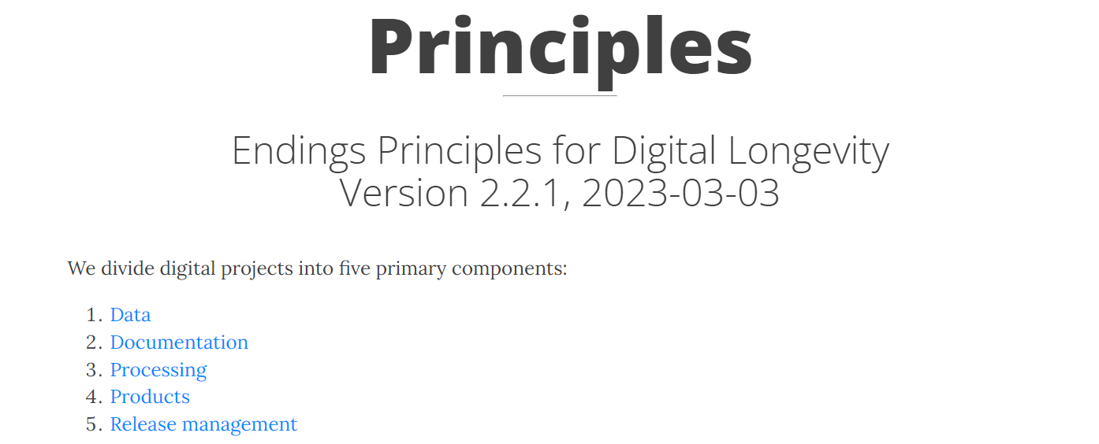
https://endings.uvic.ca/principles.html

Slide 36
Endings Principles 5: Release Management
Release management handles the public release of products. Without good release management, a project can never end gracefully.
– https://endings.uvic.ca/principles.html#release-management

Slide 37
5.1 Releases should be periodic and carefully planned.

Slide 38
5.2 A release should only be made when the entire product set is coherent, consistent, and complete (passing all validation and diagnostic tests).
Notes:
e.g., all documents are “published,” all content is “complete”

Slide 39
5.3 Like editions of print works, each release of a web resource should be clearly identified on every page by its build date and some kind of version number.

Slide 40

How MoEML does it

Slide 41
MoEML v.7.0, svn rev. 20565 2022-05-05 09:11:13 -0700 (Thu, 05 May 2022).
Notes:
svn rev = “same setting of type”?

Slide 42
5.4 Web resources should include detailed instructions for citation, so that end-users can unambiguously cite a specific page from a specific edition.

Slide 43
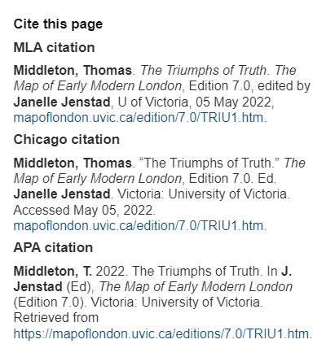

Slide 44
We want lots of static copies.
Another desirable feature of the book is its durability.
Books are durable partly because they’re multiple and scattered.
We need to do the same with a digital edition – make lots of copies.
It’s hard to make lots of copies of a complex database-driven infrastructure.
Therefore we need our digital editions to be simple, static, portable, and easily copied.

Slide 45
What is a static site?
What we release: a static, numbered edition with no server-side dependencies
HTML, JavaScript and CSS: every page is built at the same time in a single operation from a single source dataset.
You can put it on thumb drives and distribute them to run on any web server.
You can download it as a ZIP file and install it on many machines.
The copy we host at the UVic URL is the canonical copy but it’s just ONE of many static copies (like the public library copy).
Notes:
MH

Slide 46
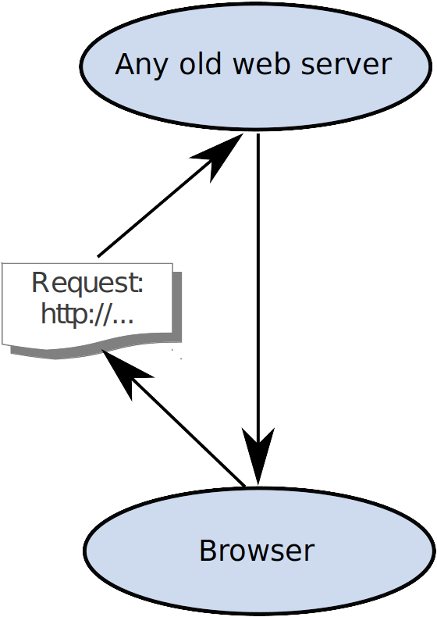
Not this:
But this:

Slide 47
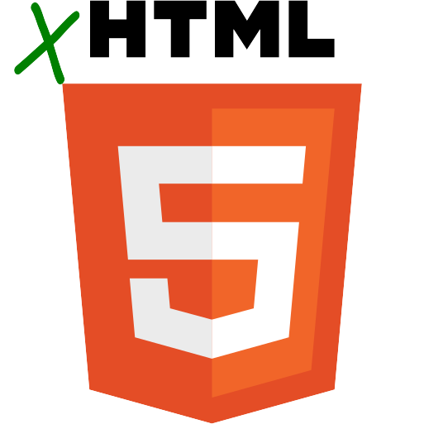


Endings Principles 4: Products (1)
4.1 No dependence on server-side software: build a static website with no databases, no PHP, no Python.
4.2 No boutique or fashionable technologies: use only standards with support across all platforms, whose long-term viability is assured. Our choices are HTML5, JavaScript, and CSS.
4.3 No dependence on external libraries or services: no JQuery, no AngularJS, no Bootstrap, no Google Search.
So: free of technical debt.

Slide 48

In other words, a pet rock.

Slide 49
Endings Principles 4: Products (2)
4.4 No query strings: every entity in the site has a unique page with a simple URL that will function on any domain or IP address.
http://graves.uvic.ca/xbrowse.xq;jsessionid=926A43
8A2B364B4B92488B9AC00AB013?
query_stored=true&collection
=/db/graves/
entries&type=diaryentry&n=19
35-02-22&start=1
https://graves.uvic.ca/diary_1935-02-22.html

Slide 50
Endings Principles 4: Products (3)
4.5 Inclusion of data: every site should include a documented copy of the source data, so that users of the site can repurpose the work easily.
4.6 Massive redundancy: every page contains all the components it needs, so that it will function without the rest of the site if necessary, even though doing so means duplicating information across the site.
4.7 Graceful failure: every page should still function effectively even in the absence of JavaScript or CSS support.
So: stable, citable, archivable, replicable, Wayback-Machinable, stealable, reusable

Slide 51
How we build a static site (1)
Validate the source XML (using RNG and Schematron).
Create generated XML documents for indexes, TOCs, listings pages, etc.
Validate this new XML.
Create “standalone” versions of all the documents, by importing copies of all linked components (bios of people, place and org info, glossary entries, etc.)
Validate this standalone XML.

Slide 52
How we build a static site (2)
Build/copy CSS, JS, images, and other resources.
Create XHTML5 output from each of the standalone XML documents.
Validate the HTML using the W3C validator.
Run additional diagnostics tests and produce reports.
Notes:
All your documents actually exist.
All your documents actually contain what they appear to contain.
Searching your documents will work more intuitively.
Each build is globally coherent, and can constitute a single edition.
Every document can function outside the collection.
Future users can take what they want, in a convenient self-contained package, in the format they need.
Everything works without a web server.

Slide 53

How do we do search on these sites?
We wrote a staticSearch engine that does not require anything server-side except a web server: https://github.com/projectEndings/staticSearch It supports stemming, wildcards, phrasal searches, and metadata filters. Try it out:
https://bcgenesis.uvic.ca/search.html

Slide 54
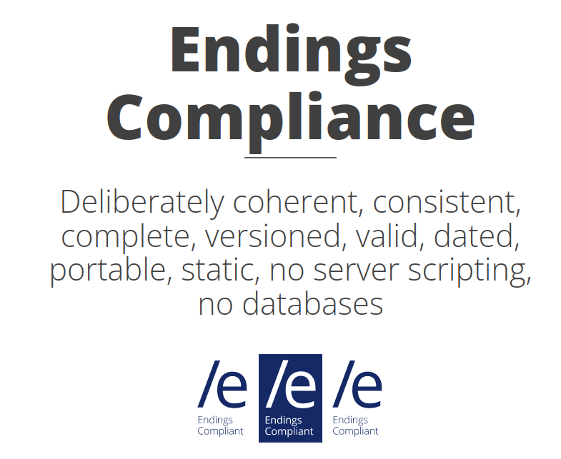
https://endings.uvic.ca/compliance.html

Slide 55
Summary
Digital editions must be citable with the precision and reliability of print editions.
Cited materials must persist and remain accessible without maintenance.
So:
For scholars, we must make coherent, consistent, complete, identifiable editions.
For developers, we must eliminate maintenance, technical debt, and vulnerability.

Slide 56
Thanks
The Endings Team: Claire Carlin, Ewa Czaykowska-Higgins, Janelle Jenstad; Stewart Arneil, Martin Holmes, Greg Newton; John Durno, Matt Huculak, Lisa Goddard; Emily Comeau and Joey Takeda
Faculty of Humanities
University of Victoria Libraries
Social Sciences and Research Council of Canada

Slide 57
APPENDIX: How the staticSearch engine works

Slide 58
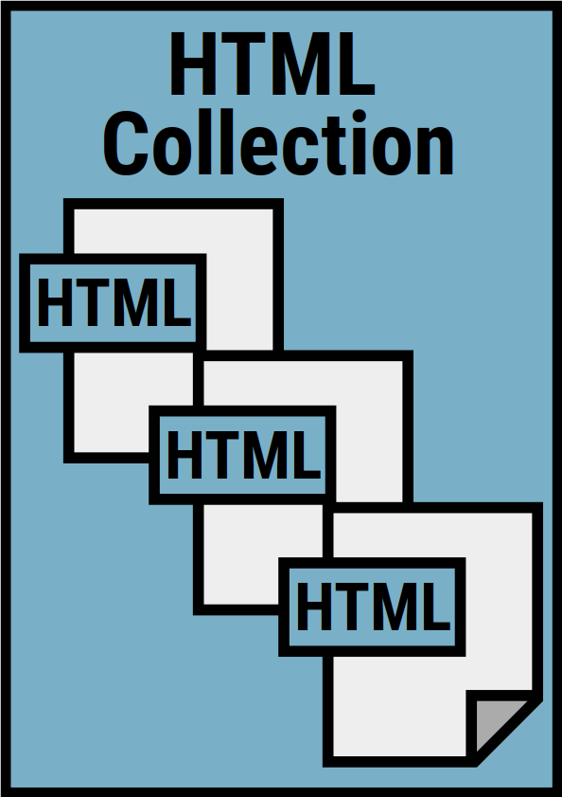
You have:
A collection of HTML files
All well-formed & valid XHTML
Notes:
We assume that your website consists of HTML5 documents which are all well-formed XML in the XHTML namespace. If they're not, then we can't process them.
So if your documents are HTML tag soup, you'll have to clean them up and fix them first. But that's a good thing anyway.

Slide 59

You add:
An HTML search page containing a special div:
<div id="staticSearch"></div>
Notes:
You need to add one new page to your site: the search page. We prefer that you add that page so that you can ensure that it matches the style of your site.
The only thing that must be in it is a single div element with the id "staticSearch". Our build process will put the search functionality into that div. If that div already has stuff in it, then it will be emptied first.

Slide 60
You add:
Some metadata elements to support search filters: <meta name="Document type" class="staticSearch.desc" content="Poems" />
Notes:
If you only want a text search, then that's all you have to do. But if you also want some search filters, such as dates or document types, then you'll need to add the information required for those filters into the metadata of your HTML files.
Here you see a document type filter element, which specifies that the document containing it falls into the "Poems" category.

Slide 61
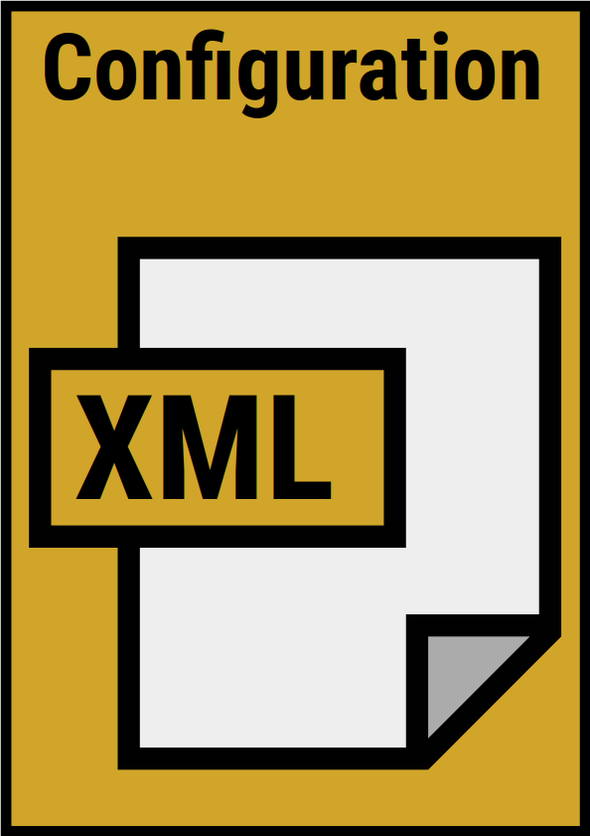
You create:
A configuration file (XML) to specify the features and constraints for your search engine
Notes:
Next, you need to create a simple XML file to specify the parameters you want to apply to your search. This is covered in our documentation, and there is a schema to validate it so that you know you've got it right.
That document tells the staticSearch build process where your HTML files are and where the search page is, and it also allows you to configure things like weighting, so you can specify for example that hits in headings count more heavily than hits inside paragraphs.

Slide 62
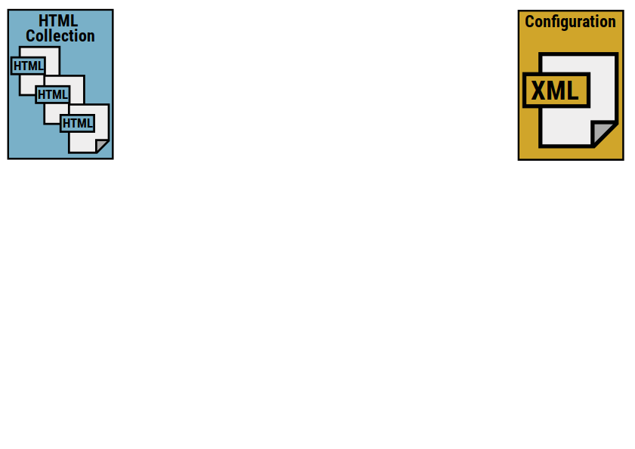
Notes:
So you have your HTML collection with its search page and your configuration file.
You run the staticSearch build process (which requires Ant). This is what happens:

Slide 63
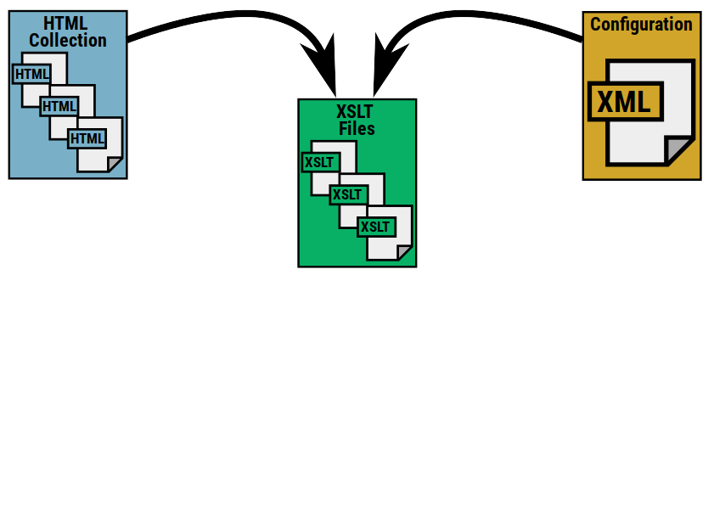
Notes:
Based on the configuration file, the XSLT processes your document collection. It doesn't modify the original documents (other than the search page); it creates temporary copies and manipulates those.

Slide 64
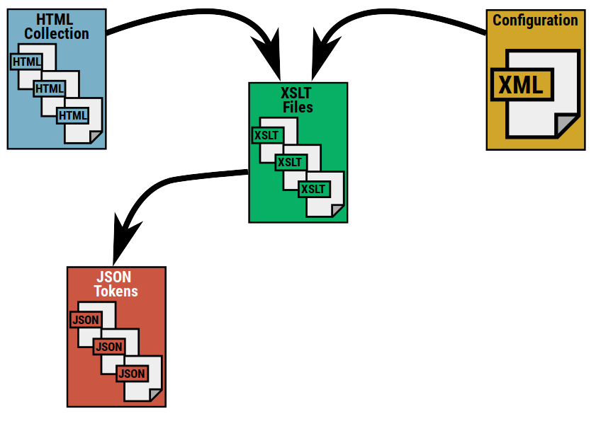
Notes:
It analyzes all the text in the documents, applies stemming to the words, and creates a large number of small JSON files.
Each JSON file contains information about one token – all the documents that contain that token, and keyword-in-context fragments for each instance.
The JSON file is named after the token it contains. This will be important later.

Slide 65
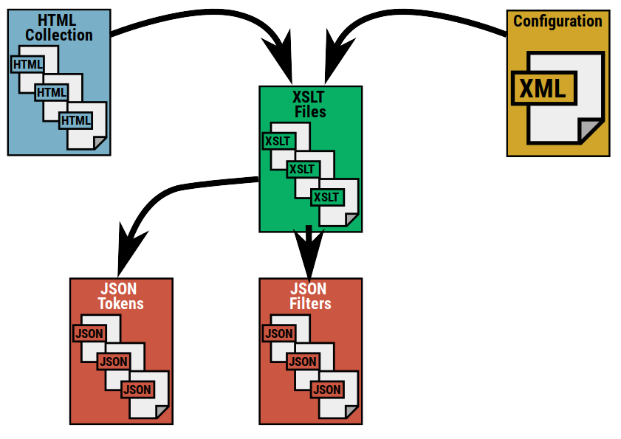
Notes:
The process also creates a JSON file for each of the filters found on the site, mapping documents to filter values.

Slide 66
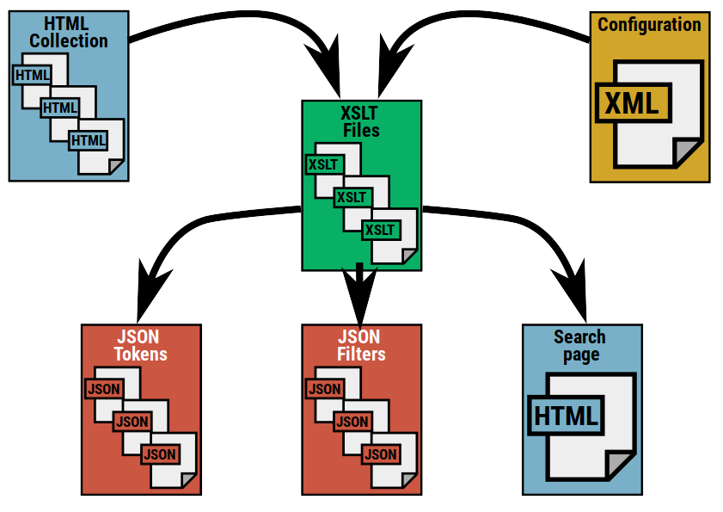
Notes:
Finally, the build process modifies the search page you created to insert the HTML, JavaScript and CSS it needs to do searches.

Slide 67
JSON token file
{"token": "unprofit", "instances": [ { "docId": "pom_2025_ithe_old_man_of_hoy", "docUri": "poems/goodwords/1870/pom_2025_ithe_old_man_of_hoy.html", "score": 1, "contexts": [ { "form": "unprofitably", "context": "…whole that day was spent <mark>unprofitably<\/mark>.", "weight": 1, "pos": 400 } ] }, { "docId": "pom_8733_john_and_joan_canto_ii", "docUri": "poems/blackwoods/1820/pom_8733_john_and_joan_canto_ii.html", "score": 1, "contexts": [ { "form": "unprofitable", "context": "…too much ap- propriated unto <mark>unprofitable<\/mark> jocularities and facetiousness. Craving licence,…", "weight": 1, "pos": 164 } ] } ] }
Notes:
This is what a JSON file for a single token looks like.
This token is for the stemmed form "unprofit".
It appears in two documents in the collection, once as "unprofitably" and once as "unprofitable".
A keyword-in-context fragment is stored for each instance.
Note that KWICs are optional; they take up more disk space, of course, so for a large collection you might turn them off or constrain their numbers in the configuration file.

Slide 68
Filter JSON
{ "filterId": "ssBool2", "filterName": "Unsigned", "ssBool2_1": { "value": "true", "docs": [ "poems/chambers_series/1867/pom_7594_the_husbands_request.html", "poems/alltheyearround/1875/pom_4271_the_hourglass.html", "poems/alltheyearround/1879/pom_4507_in_the_conservatory.html", "poems/blackwoods/1843/pom_9963_jolly_father_joe.html", "poems/blackwoods/1829/pom_10314_the_watchmans_lament.html" ] } }
Notes:
This is what a JSON filter file looks like.
This is for a boolean (true/false) filter called "Unsigned", meaning (in this case) that a poem appears in a publication without a signature.
It lists five poems which match this criterion. (This is a simplified version, of course; there are many poems in this particular collection which are unsigned.)

Slide 69
On the website...
...of the thousands of JSON files...
...the search page JS retrieves only the ones it needs for the search you do:
Notes:
All those JSON files are added into your website, along with the modified search page, and you can now use the search function.
If the search page had to retrieve all the thousands of little token files created by the build process, it would take forever. But it doesn't; it only needs to retrieve the ones that are needed for each specific search.

Slide 70
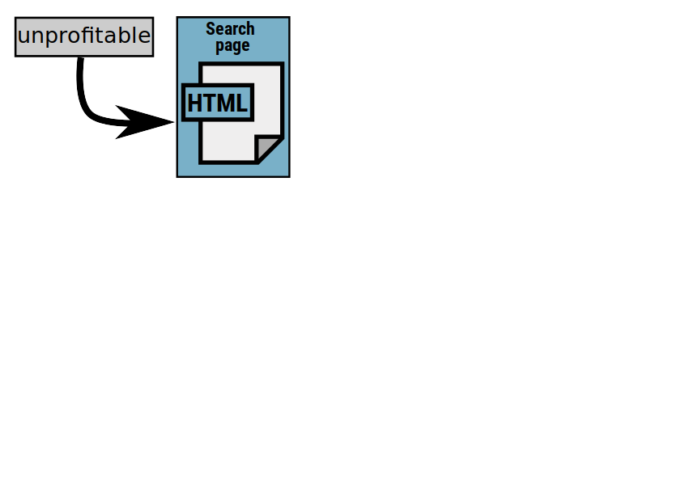
Notes:
So if you type the word "unprofitable" into the search page and initiate a search, this is what happens:

Slide 71
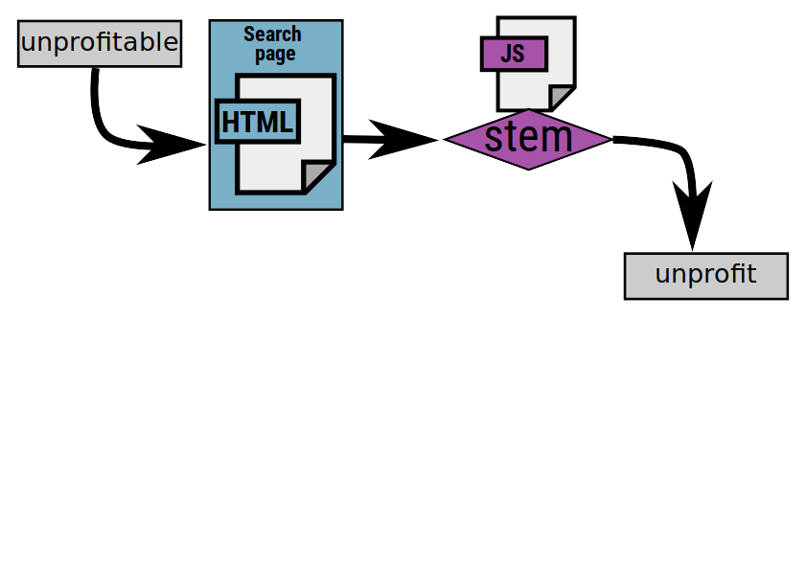
Notes:
First, that word is stemmed to get the token "unprofit" (there is a JavaScript implementation of the stemmer as well as the XSLT implementation that creates the token files).

Slide 72
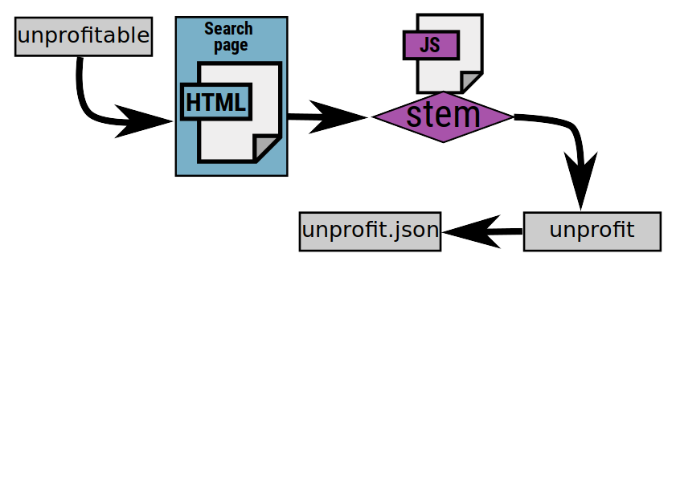
Notes:
From that token, it infers the name of the JSON token file that it needs to retrieve for this search.

Slide 73
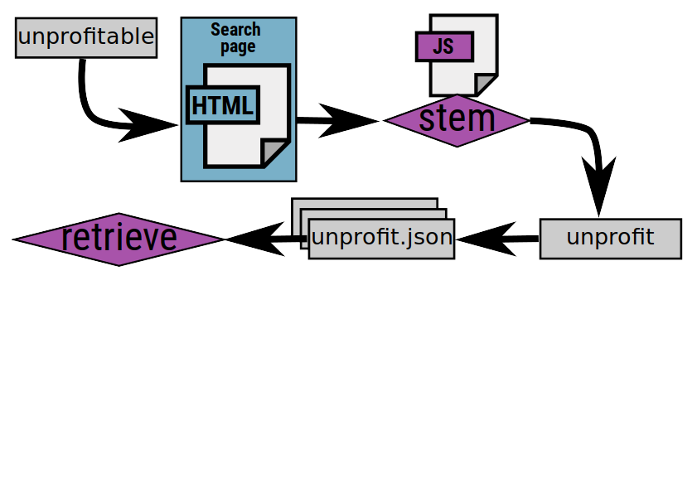
Notes:
It does the same for any other words typed into the search box, and also identifies any filters that have been applied to the search, so that it can retrieve the appropriate filter JSON files. Then it gets those files (assuming it doesn't have them already from a previous search).

Slide 74
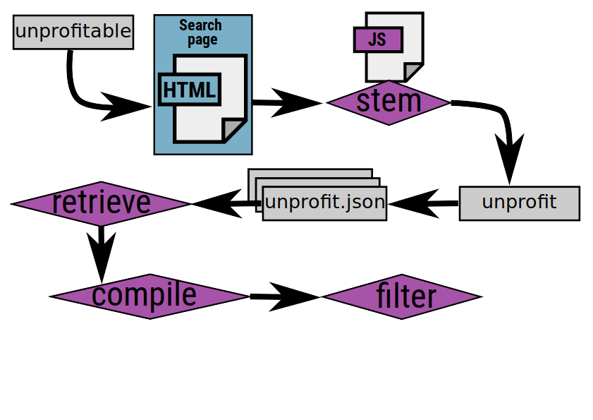
Notes:
Once the JSON is all retrieved, it compiles the hits from the tokens and filters the results...

Slide 75
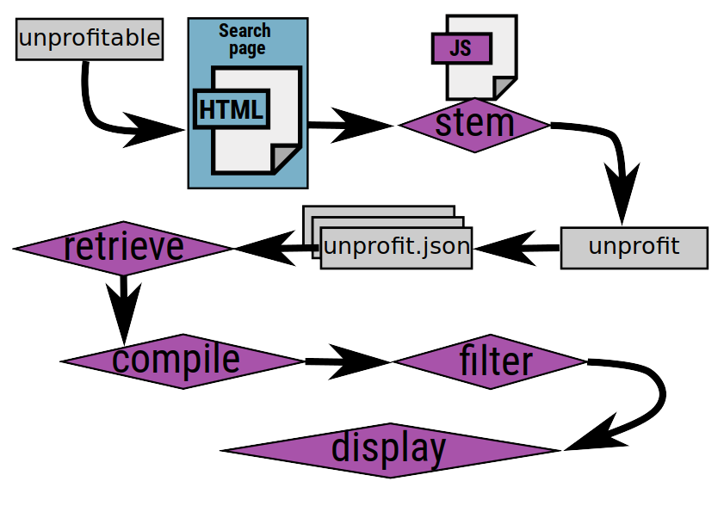
Notes:
...and it displays the results for the user, providing keyword-in-context matches if it's been configured to do that.

Slide 76
